Slide 1
How to create a product strategy and roadmap
Darren Beaumont

Slide 2
Product principles
VISION
[ Why ]
STRATEGY
[ Where + How ]
ROADMAP [ What ]
Notes:
Sharing this for alignment around how I define Strategy and Roadmap, and why I have added Vision to the puzzle.
Company Vision and Mission > Product Vision
Company Vision = desired future position of the company. High level customer benefits ”Provide the world’s best customer experience every day.”
Company Mission = company’s business, objectives and approach “Become essential to our customers by providing differentiated products and services to help them achieve their aspirations.”
Product Vision = “North star” for all product development. What is the purpose for creating the product and what positive change should it bring about? Sitting at the tip, it should be the most succinct and most stable element of the product strategy pyramid.
Product Strategy - describes who your customers are, how your product fits into the current market, and how it will achieve business goals. Where will we play? How will we win! (market and its constraints (e.g. geography), value proposition, USPs, relative costs, growth model) --- Customer Value + Competitive position + Business Value
Product Roadmap – communication tool to gain alignment on what you will do to deliver on strategy --- Themes not features; Horizons, not dates; Higher granularity for near term
Diagram from: https://jefago.medium.com/product-vision-strategy-roadmap-175d638fe93c

Slide 3
Key principles of Product Strategy
VISION
STRATEGY
ROADMAP
Strategy and roadmap are living things
Aligned to mission and vision
Driven by customer needs
Outcome and data-driven
Developed collaboratively
Embrace experimentation and continuous discovery
Foster autonomous, empowered teams
Notes:
Living artefact – evolves as more research comes to life – but stable
Collaboratively
Inc customers, stakeholders, product team
Give delivery teams the strategic context, product goals and framework to prioritise and make decisions within. Treat them as problem solvers (missionaries), not builders (merconaries)
Marty Cagan 4 Risks:
Value risk: Will the customer buy this, or choose to use it?
Usability risk: Can the user figure out how to use it?
Feasibility risk: Can our engineers build what we need with the time, skills, and technology we have?
Business viability risk: Does this solution also work for the various aspects of our business?
Experimentation to reduce risk of unknowns and find solutions with greatest chance of success
Hypothesis or assumption to test
Identify what want to learn
Identify minimum to build to enable learning
Measure impact + draw conclusions
Repeat

Slide 4
Creating a strategy and roadmap
 | Product Vision
 | Insights
 | Product Goals
 | Product Roadmap
 | Product Delivery
Define where we want to go and why.
Understand the market and our target customers.
Identify strategic objectives based on insights.
Define prioritised actions and plan to meet goals.
Deliver strategy and outcomes from roadmap.
1
2
3
4
5

Slide 5
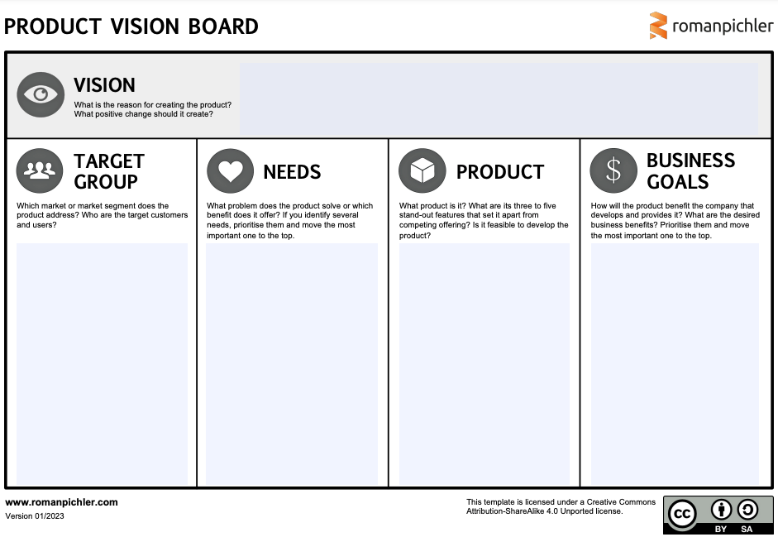
Product Vision
VISION
1
STRATEGY
ROADMAP
Product Vision board
Notes:
Vision statement – Why! What is the reason for creating the product? (i.e. customer problems to solve / jobs to be done) What positive change should it create?

Slide 6
Product Strategy
VISION
1
STRATEGY
ROADMAP
Product Vision board
Template from
Notes:
Vision board
Target group – Which market or market segment does the product address? Who are the target customers and users?
Needs – What problem does the product solve or which benefit does it offer?
Product – What product is it? USPs: What are its three to five stand-out features that set it apart from competing offering? Is it feasible to develop the product?
Business goals – strategic context. How will the product benefit the company that develops and provides it? What are the desired business benefits? Prioritise them and move the most important one to the top. Amex business strategy:
Differentiation strategy. Innovate
Customer experience focus.
Be clear about
Timeframe for getting to target state
Geos and Techs to compete in
The role of partners and suppliers
Business alignment – Define alignment with user, market and business goals
Define the Value Proposition
Unique Selling Proposition (USP): Craft a compelling USP for your credit cards that differentiates them from competitors, focusing on benefits such as rewards, low interest rates, or no annual fees.
How:
Stakeholder Alignment: Meet with key stakeholders (e.g., executives, marketing, sales, customer service) to understand the company’s business goals, such as increasing market share, targeting specific customer segments, or enhancing brand reputation.
Strategy alignment: Review internal and external business vision and strategy documents
$$$: Talk to finance to understand company commericals and focus markets
KPIs: Identify key performance indicators (KPIs) like the number of new applications, approval rates, customer lifetime value (CLTV), or conversion rates from website visits to applications. Align with other teams

Slide 7
Insights
VISION
2
STRATEGY
ROADMAP
Product artefacts:
Customer
User research
Customer segmentation
Product
Site usage analysis
Segmentation usage analysis
Review user session recordings
Business
Business model review
Identify constraints, needs and opportunities
Market
Competitive analysis
Industry trends
Technology trends
User personas
Customer journey maps
Opportunity space tree map
Site usage reports
Acquisition funnel analysis
Value proposition canvas
Competitor analysis table
SWOT analysis
RAID log
PESTLE template
Opportunity backlog
Notes:
Goal:
Generate, identify and leverage insights.
Gain quantatitive and qualitatitve (evaluative vs generative) insights into the market to enable data-informed strategy and decisions
Know your…
Customer
Insights / User Research: Conduct surveys, interviews, usability studies, etc for insights into needs, desires, customer pain points, motivations, behaviurs, spending behaviours, decision making process and preferences when applying for a credit card online.
Ask customers to talk through a customer journey they took to achieve a product related goal.
How do customers achieve their goals today / how use our products
Identify unmet user needs
Customer segmentation - Identify and prioritize target customer segments (e.g., millennials, small business owners, frequent travellers) by analysing demographics, behaviour, and needs. User interviews to ellicit user stories of how they did something and how it made them feel
Opportunity map - capture opportunities = need, pain or desire. Use a tree structure to group and summarise customer opportunities. Assess opportunities using weighted prioritisation scoring Frame the problem. When given a solution clarify the underlying problem or unmet need
Product
Site Usage → Sales Funnel analysis. Awareness > Interest > Evaluation/Consideration > Desire > Action/Conversion
Customer segmentation analysis – location; device; existing vs new (if known). Are all using the same way? Any anomalies?
Commercials analysis
Consider additional experiments to capture missing data – e.g. collecting bounce info (e.g. via survey / chatbot) when someone navigates away from Product Shopping Experience page or application process
Any heatmap type data or screen recordings?
Customer feedback - Product reviews, company reviews, website reviews, support CSAT reviews
Customer churn data – e.g. call data
Business
Talk to key stakeholders to identify any constraints, needs and opportunities
Market
Competitive analysis: Analyse competitors’ digital acquisition strategies, focusing on website features, UX/UI, promotions, and messaging. Identify gaps and opportunities. Develop value proposition and product differentiation
External factors that could disrupt and innovate - PESTLE: political, economic, social, technological, legal, environmental)
Other ways to shop / acquire customers
Innovation – using new and disruptive tech to solve existing problems in better ways. E.g.
GenAI (e.g. for tailored marketing messaging)
Assisted shopping Experiences and Chatbots
New social media and marketing tools / platforms / integrations
New technology (e.g. Apple Vision)

Slide 8
Product Goals
VISION
3
STRATEGY
ROADMAP
Focused set of critical problems to solve [Opportunities]
Insights powering our product strategy
OBJECTIVES
KEY RESULTS
Goals – customer or business problems to solve
How we measure progress and know if we’ve succeeded
2-3 per team (per quarter)
3-5 per objective
OKRs are a stretch. Goal to hit 60-80%
Notes:
Goal to convert insights into actions that go on the roadmap - actions that align to these product goals.
For empowered teams, give teams problems to solve – not features!
Feature teams = mercenaries
Problem solving teams = team of missionaries.
E.g. Market share; conversion rate; app completion rate; approval rate
Align to business goals
Explain strategic context to delivery team inc the product strategy. Then tell teams which problems to work on and what business results they should measure.
Define Objectives (goals) and Key Results (how we know we have succeeded) e.g. Increase new member acquisition while ensuring high-quality customer growth and decreasing cost of new customer acquisitions.
Make them SMART – be clear about timeframe, markets, segments
Prioritization Framework: Use frameworks like RICE (Reach, Impact, Confidence, Effort) or MoSCoW to prioritize opportunities based on impact on customer acquisition and business goals.
Opportunity assessment. Answer 4 questions
Objective: What business objective is this work intended to address?
Key results: How will you know if you’ve succeeded?
Customer problem: What problem will this solve for our customers?
Target market: what type of customer are we focused on?

Slide 9
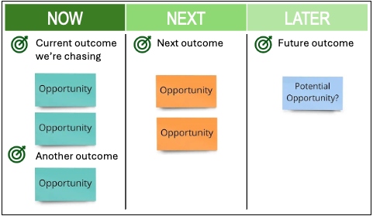
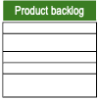
Product Roadmap
VISION
4
STRATEGY
ROADMAP
Feature roadmap Outcome based roadmap
Product Vision
Product Strategy
Goals (Objectives + Key Results)
Opportunity map
Weighted scoring of opportunities
NOW | NEXT | LATER
Current outcome we’re chasing Another outcome | Next outcome | Future outcome
Product backlog
Outputs [Experiments, Features]
Notes:
Roadmap manages outcomes Backlog manages outputs
Product initiatives – can include experiments, feature developments, marketing campaigns, process improvements, etc
Prioritisation based on alignment with vision and strategy – e.g. RICE prioritization / weighted scoring
Action plan = Roadmap
Features roadmap
Outcome driven roadmap
Problems to solve + measures of success
Product initiative goals aligned to product goals
Horizon based Now / next / later – with more details closer to current

Slide 10
Product Delivery
VISION
5
STRATEGY
ROADMAP
Alignment
Empowerment
Problem solving
Iterative value
Risk
Regularly communicate and share
Experiment, measure, learn, repeat
Test and validate with customers
Manage risks, remove blockers
Pivot when not working
Notes:
How to support teams to deliver on objectives and key results
Experiment/build, measure, learn and repeat.
Refine roadmap as we learn more.
Tailor Communication to the Audience
Regularly communicate progress, challenges, and changes to stakeholders to maintain alignment and manage expectations
For Executives and Stakeholders: Focus on strategic alignment, ROI, and high-level timelines. Keep it concise and emphasize how the product contributes to business goals. Ensure everyone buys into the vision, objectives and initiatives.
For Product Teams: Provide more detailed information, including specific features, timelines, and technical considerations. Emphasize collaboration and clear roles.
For Customers or Users: Highlight the benefits they’ll receive, the problems the product will solve, and any upcoming features they can look forward to.
Encourage feedback, collaboration and regular updates to foster a sense of ownership and shared responsibility.
Use Visuals and Tools
Roadmap Visualization: Use visual tools (like Gantt charts, Trello, or roadmapping software) to create a clear, easy-to-understand roadmap. Ensure it’s visually engaging and straightforward.
Opportunity map: use this to walk stakeholder through how opportunities and goals relate and why you are working on one area. Encourage feedback and input to map to evolve it.
Presentations
Product Demos: If possible, show a demo or prototype to make the strategy and roadmap more tangible.
Facilitate Feedback and Collaboration
Regular Updates: Hold regular meetings to update stakeholders on progress and adjust the roadmap as necessary. Transparency is key.
Open Channels for Feedback: Encourage feedback from all levels—executives, teams, and users. Use tools like surveys, focus groups, or Q&A sessions.
Cross-functional Collaboration: Ensure that all relevant departments (marketing, sales, engineering, etc.) are aligned and have input into the strategy and roadmap.
Support team
1-1’s: What working on = problems; what learnings have you discovered = insights; what things are you working on to address these insights = actions; what challenges/issues/blockers can I help you overcome = active management
Coaching: are we working on the right objectives/problems/priorities; what other insights could we generate; do we have the right focus; do we need to pivot; fall in love with problems not solutions; are we actively engaging customers enough to discover unmet needs (generative research) and test ideas to problems (evaluative research)
Subservient leadership: How can I help you achieve your key results? Remove blockers. Champion team, focus areas and needs. Celebrate successes
Document Everything
Detailed Documentation: Create comprehensive documentation that includes the product strategy, detailed roadmap, and any supporting information. Make this accessible to everyone involved.
Single Source of Truth: Use a centralized platform (like Confluence, Jira, or a shared drive) where all documentation and updates are stored.
Stay Agile and Adaptive
Continuous Review: Regularly revisit the strategy and roadmap to ensure they remain relevant. Be prepared to pivot if market conditions, customer needs, or internal priorities change.
Transparent Communication: Communicate any changes to the strategy or roadmap clearly and promptly. Explain the reasons behind changes to maintain trust and alignment.
Engage and Inspire
Storytelling: Use storytelling techniques to make the product strategy compelling. Relate it to the company’s broader narrative and vision. Use analogies where necessary.
Celebrate Milestones: Recognize and celebrate when key milestones are achieved. This keeps the team motivated and aligned with the product vision.

Slide 11
Summary of the approach
PRODUCT
VISION
Insights
Problem validation
PRODUCT STRATEGY
Opportunities
Market
Differentiators
Goals
Opportunity backlog
Product goals
1
Product Vision
Market Insights
Product Goals
Product Roadmap
Product Delivery
MEASURE IMPACT + CAPTURE FEEDBACK / INSIGHTS
PRODUCT ROADMAP
2
3
4
Learn
Measure
5
PRODUCT (INCREMENT)
PRODUCT BACKLOG
Build
Notes:
Product vision – WHY: what is the products purpose? What positive change should it bring about?
Product strategy – WHERE: will we focus? – HOW: what is our approach to realise the vision and make the product successful? How will product support company strategy and business goals.
The strategy defines what we want to achieve, and why! It describes who your customers are, what they need how your product fits into the current market, and how it will achieve business goals.
Differentiators = Stand-out features
Output of market insights is an Opportunity backlog.
Opportunities are then priorities according to strategy alignment and key measures of success
The most critical opportunities are selected as part of the strategy – so we solve the most important problems
The roadmap defines how we plan to deliver on product vision and strategy (goals) – it is a prioritised action plan focusing on the most important problems
Within Delivery, we want to ideate and test potential solutions to problems to reduce risk and identify solutions with greatest chance of improving our measures of success.
Product backlog – which UX designs and features are required to achieve the next product goal? Includes epics, user stories, workflow diagrams, prototypes, NFRs
Build / Measure / Learn is a cornerstone of the Lean Startup book by Eric Ries
I’m an advocate for Dual Track Agile – Continuous Discovery and Continuous Delivery
Diagram adapted from Roman Pichler Product Strategy Model https://www.romanpichler.com/blog/my-product-strategy-model/

